Slide 1
US Customer Architecture
Notes:
Bottom-up view of enabling Data Capabilities in support of prioritized business capabilities
- Iterative approach to building out capabilities incrementally though data enablement – Clean data available and under management - Master Data managed under MDM and both Master and Transaction Data Available within the Data Hub
Business Capabilities sequencing and timelines are still subject to Top-Down Analysis under the Program Governance & Alignment and Technology Solutioning Towers (taking place over the next 3-4 months, but subject to funding)
- Programs need to re-align priorities and release plan, cross-program gaps and dependencies need to be revisited and programs must be funded and resourced accordingly. This is especially impacted by program gaps in CRM and Automated
Marketing capabilities
- Note: CRM and Marketing Automation Completes in Dec 2022
Timelines for many of the required business capabilities extend beyond May-2022 which are being driving by process and tech changes
Some Capabilities that the Blueprint suggests will be dependent on a step change in platform can begin to be enabled by a Step change in data (e.g. Billing Insights). Other such as (New Service Connect) will obviously be clearly be dependent on AMI service

Slide 2
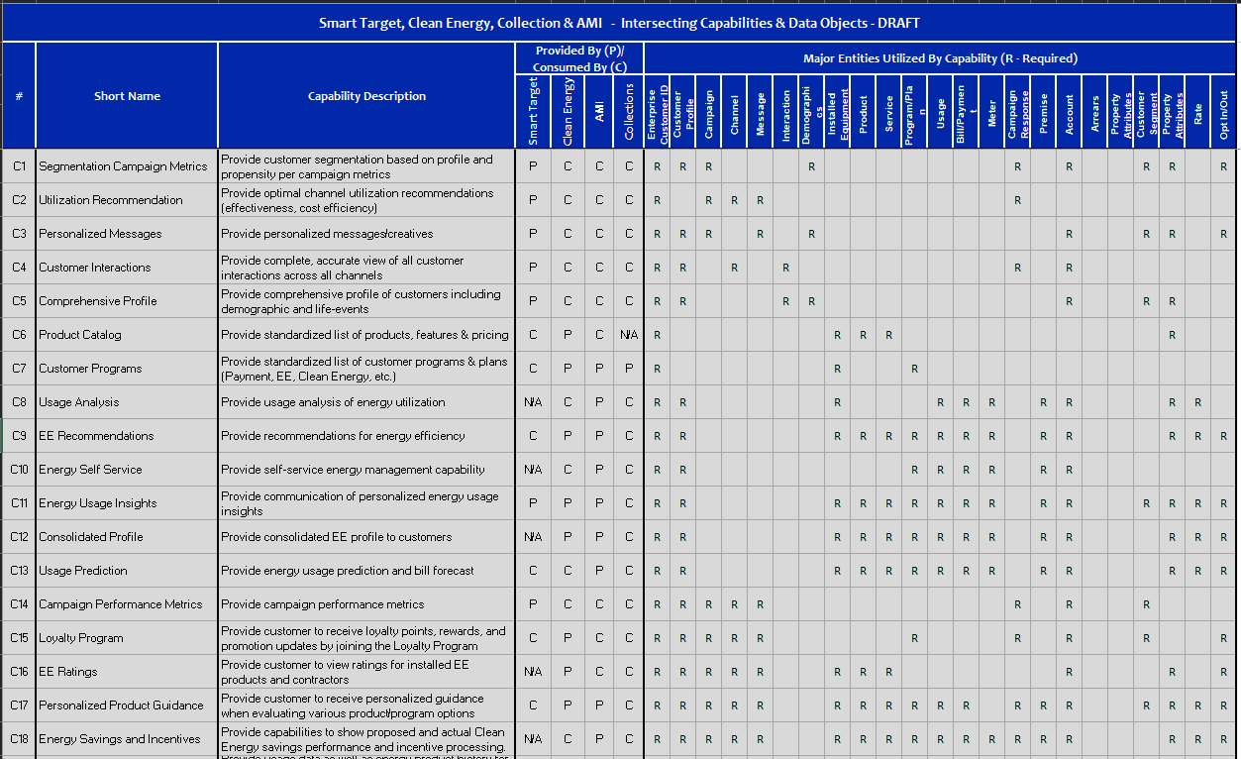
US Customer Capabilities by Programs

Slide 3

US Customer Business Capabilities Proposed Roadmap (Draft)
Delivery / Value Streams:
Data Management Foundational
Customer Data Foundational
Customer Data Integration Services
2021
2022
May
Jun
Jul
Aug
Sep
Oct
Nov
Dec
Jan
Feb
Mar
Apr
May
Jun
Jul
Aug
Sep
Oct
Nov
Dec
Releases:
MVP R1
MVP R2
MVP R3
MVP R4
Business Capabilities Support
Informatica Catalog, Governance and Quality Tools available
C7 – Product Catalog
C8 – Customer Programs
C1 – Segmentation Campaign Metrics
C3 – Personalized Messages
C13 – Consolidated Profile (Partial)
C9 – Usage Analysis
C2 – Utilization Recommendation
C4 – Customer Interactions
Reltio MDM and Matillion Tools available
C14 – Usage Prediction
C5 – Comprehensive Profile
C15 –Campaign Performance Metrics
C10 – EE Recommendations
C8 – Customer Programs
C16 – Loyalty Program
C11 – Energy Self Service
C12 – Energy Usage Insights
CRIS and CSS CDC (for MVP1)
CRIS and CSS CDC (for MVP2)
C17 – EE Ratings
C18 – Personalized Product Guidance
C20 – Usage History
C19 – Energy Savings and Incentives
C22 – Proactive Usage Feedback
C21 – Enrollment Offers
C23 – Outage Status
C25 – Customer Balance
Customer Demographic,
Preference, Premise, Billing Account, Meter
MDM/DQ/DG (Reltio)
Customer Data model, Data Catalog, Data Governance, Data Quality Profiling, CDC, Business Rules/Requirement
Persistent ID (leverage UDM) , Key Customer Profile and contact fields, Service Account
Customer, Segments,
Customer Programs/Plans
CDP (Snowflake) -Enterprise
Persistent ID (leverage UDM) , Key Customer Profile and contact fields, Service Account
Usage, Bill/Credit/Payment, Customer Demographic,
Preference, Premise, Billing Account, Meter
Customer Segments,
Customer Program/Plan, Campaign, Campaign Response, IVR
Customer Interaction,
Messages, Addition Customer Data
CDP (Snowflake) – Raw/Stage
Persistent ID (leverage UDM) , Key Customer Profile and contact fields, Service Account
Usage, Bill/Credit/Payment, Customer Demographic,
Preference, Premise, Billing Account, Meter
Customer Segments,
Customer Program/Plan, Campaign, Campaign Response, IVR
Customer Interaction,
Messages, Addition Customer Data
Notes:
Bottom-up view of enabling Data Capabilities in support of prioritized business capabilities
- Iterative approach to building out capabilities incrementally though data enablement – Clean data available and under management - Master Data managed under MDM and both Master and Transaction Data Available within the Data Hub
Business Capabilities sequencing and timelines are still subject to Top-Down Analysis under the Program Governance & Alignment and Technology Solutioning Towers (taking place over the next 3-4 months, but subject to funding)
- Programs need to re-align priorities and release plan, cross-program gaps and dependencies need to be revisited and programs must be funded and resourced accordingly. This is especially impacted by program gaps in CRM and Automated
Marketing capabilities
- Note: CRM and Marketing Automation Completes in Dec 2022
Timelines for many of the required business capabilities extend beyond May-2022 which are being driving by process and tech changes
Some Capabilities that the Blueprint suggests will be dependent on a step change in platform can begin to be enabled by a Step change in data (e.g. Billing Insights). Other such as (New Service Connect) will obviously be clearly be dependent on AMI service

Slide 4
US Customer High Level Plan for MVP 1 (WIP)
Delivery / Value Streams:
Data Management Foundational
Customer Dara Foundational
Customer Data Integration Services
2021
2022
May
Jun
Jul
Aug
Sep
Oct
Nov
Dec
Jan
1-15
16-31
1-15
16-30
1-15
16-31
1-15
16-31
1-15
16-30
1-15
16-30
1-15
16-30
1-15
16-31
1-15
16-31
Tools Funding Approve
Sign Reltio MDM Contract
MDM Reltio Environment Available
Customer Data Catalog
Customer Data Governance
Business Requirements and Rules
CRIS/CSS CDC
Customer MVP 1 - Persistent ID (leverage UDM) , Key Customer Profile fields, Product, Account
Customer MVP 2
Customer MVP 1 - Persistent ID from UDM, Key Customer Profile fields, Product, Account
Customer MVP 2
Legend
MDM
CDP
DC/DG/DM
Requirement
Other
Notes:
Bottom-up view of enabling Data Capabilities in support of prioritized business capabilities
- Iterative approach to building out capabilities incrementally though data enablement – Clean data available and under management - Master Data managed under MDM and both Master and Transaction Data Available within the Data Hub
Business Capabilities sequencing and timelines are still subject to Top-Down Analysis under the Program Governance & Alignment and Technology Solutioning Towers (taking place over the next 3-4 months, but subject to funding)
- Programs need to re-align priorities and release plan, cross-program gaps and dependencies need to be revisited and programs must be funded and resourced accordingly. This is especially impacted by program gaps in CRM and Automated
Marketing capabilities
- Note: CRM and Marketing Automation Completes in Dec 2022
Timelines for many of the required business capabilities extend beyond May-2022 which are being driving by process and tech changes
Some Capabilities that the Blueprint suggests will be dependent on a step change in platform can begin to be enabled by a Step change in data (e.g. Billing Insights). Other such as (New Service Connect) will obviously be clearly be dependent on AMI service

